Slide 1

Forms Library Team Research
Review Page - Round 2 Usability Research Findings

Slide 2
What is the Forms Library Team?

Slide 3

What is the Forms Library Team (FLT)?
The Forms Library Team (FLT) is part of the VA.gov Platform Teams. We are one of four “Spike teams” tasked with improving the forms library for VFS teams.

Slide 4
Background and goals
Review Page Round 2 Usability Findings | August 2022
In a continuation of research kicked off in April, the Forms Library team developed two new Review Page designs and tested their usability in a second round of research.
The findings from this research will help the team better understand Veteran needs and expectations around the Review Page. The Review Page pattern that best suits Veteran needs will be chosen to build in an upcoming iteration of the new VA Forms System Core (VAFSC) package.
Our goals were to understand:
How Veterans use the Review Page in the forms experience by using the Application for Burial Benefits form Review Page (21P-530) as an example.
Pain points and accessibility issues on the Review Page of the Application for Burial Benefits form experience.
How Veterans interact with the Review Page components in order to determine which of the design variations best suit their needs and has the best usability.

Slide 5
How this research maps to the Veteran journey
Review Page Round 2 Usability Findings | August 2022
Starting up
Taking care of myself
Reinventing myself
Putting down roots
Aging
Dying
Reinventing myself
Joining
Serving
Getting out
Starting up
Taking care of myself
Retiring
Aging
Dying
Putting down roots
For a fully detailed Veteran journey, go to https://github.com/department-of-veterans-affairs/va.gov-team/blob/master/platform/design/va-product-journey-maps/Veteran%20Journey%20Map.pdf
Serving and separation
Living civilian life
Retiring and aging

Slide 6
What did we do?

Slide 7
OCTO-DE goals that this research supports
Review Page Round 2 Usability Findings | August 2022
Supported
Not supported
Veterans and their families can apply for all benefits online
Veterans and their families can find a single, authoritative source of information
Veterans and their families trust the security, accuracy, and relevancy of VA.gov
Veterans can manage their health services online
VFS teams can build and deploy high-quality products for Veterans on the Platform
Logged-in users have a personalized experience, with relevant and time-saving features
Logged-in users can update their personal information easily and instantly
Logged-in users can easily track applications, claims, or appeals online
Completion rate of online transactions
Percent of applications submitted online (vs. paper)
Veteran satisfaction with VA.gov
Benefit use and enrollment, across all business lines
Benefit value (in $) delivered from online applications or transactions
Number of VA.gov users as a function of total Veteran population
Usage of digital, self-service tools
Measures to increase
Time to successful complete and submit online transactions
Time to process online applications (vs. paper)
Call center volume, wait time, and time to resolution
Time from online benefit discovery to benefit delivery
Measures to decrease

Slide 8
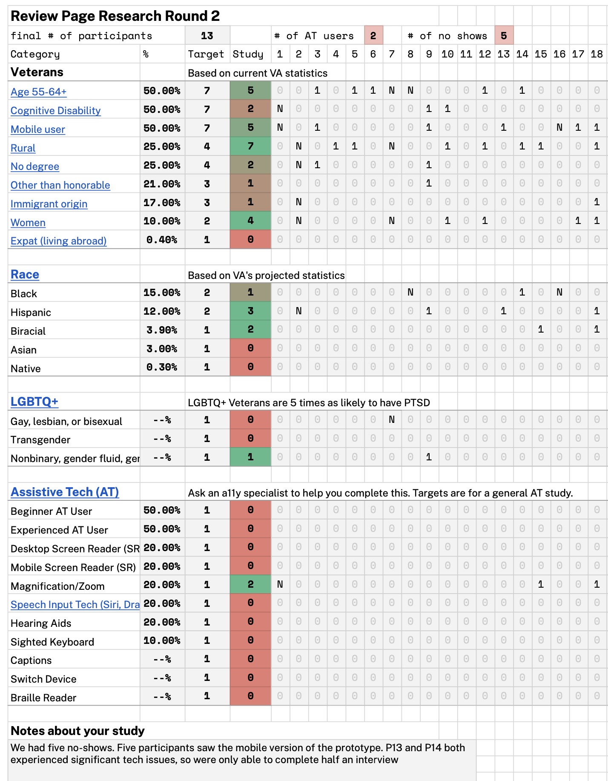
Participant Demographics
Review Page Round 2 Usability Findings | August 2022
Participant Tracker on Google Sheets
Due to no-shows and recruiting results, we did not reach our target of speaking with Veterans:
With cognitive disabilities
Identify as LGBTQ+
Identify as Black, Asian, or Native
We recommend studies with these underserved groups in the future.
This study was also not able to target accessibility tools like screen readers, since it was not a live code prototype, but that should be explored in future studies.

Slide 9

Research Method
Review Page Round 2 Usability Findings | August 2022
METHODOLOGY
To learn about the Veteran’s perspective, we conducted 1:1 semi-structured interviews over Zoom to understand their experience working with different proposed designs of the Review Page. The team chose the Burial Benefits form (21P-530) for this research effort.
We presented two different designs of the review page as a clickable prototype to determine which would be more usable.
Half of interviews were done with a desktop prototype, and half were done with a mobile prototype.
Participants were asked to complete a simple, not-so-simple, and complex edit on each design.
13
Moderated / Zoom
Semi-structured interview
DATES/DETAILS
July 6-27, 2022

Slide 10
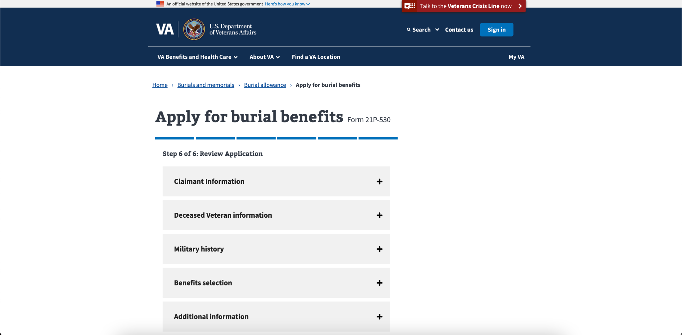
Current Desktop Design
Review Page Round 2 Usability Findings | August 2022

Slide 11
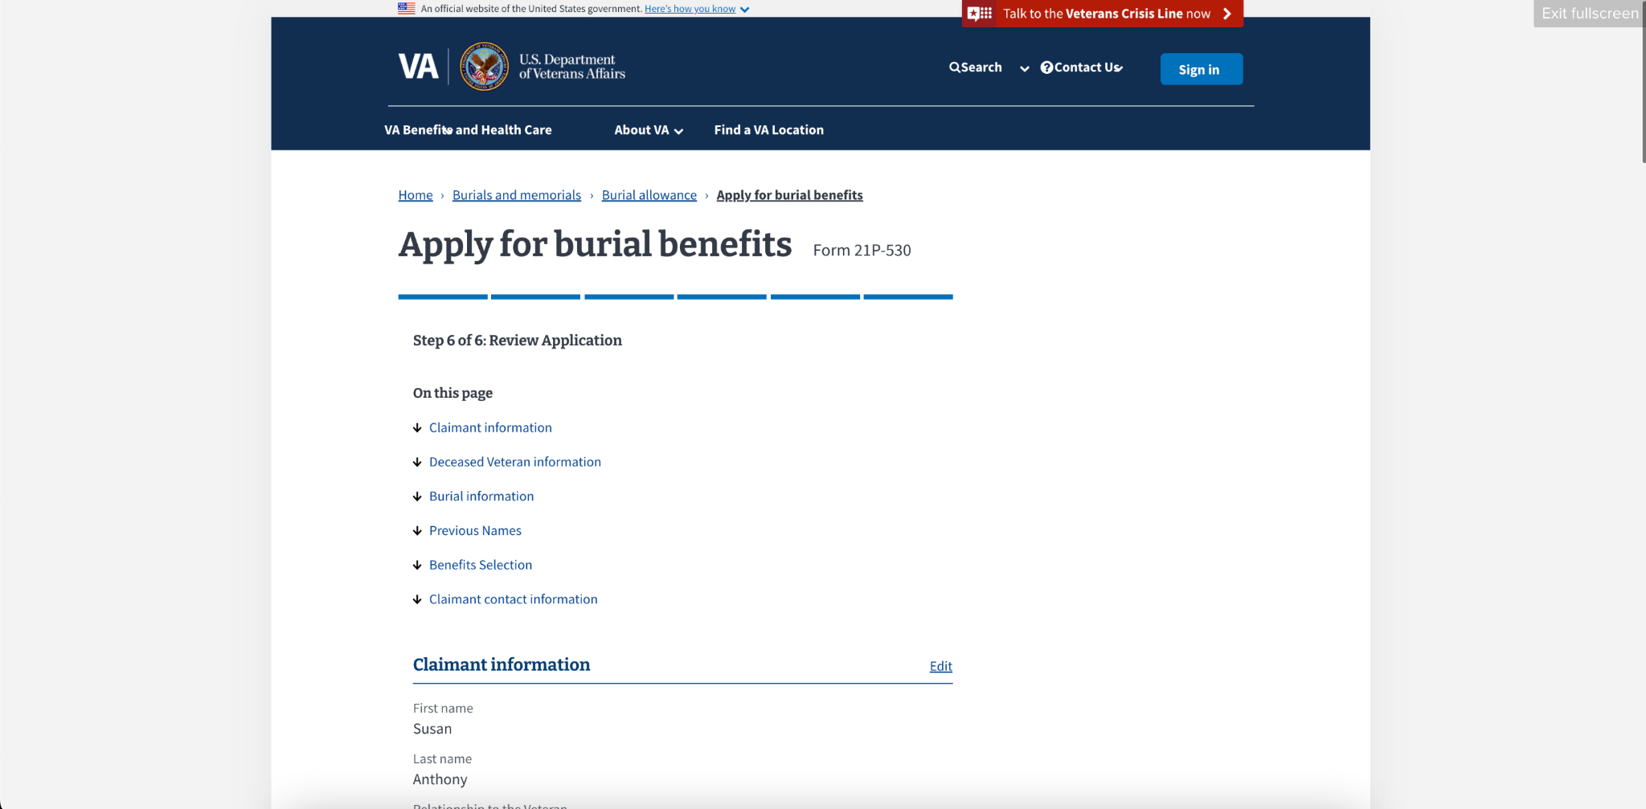
Desktop Design Option #1 - Edit by Section
Review Page Round 2 Usability Findings | August 2022

Slide 12
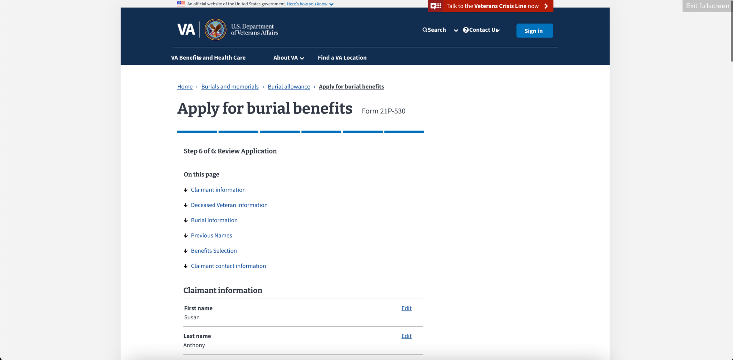
Desktop Design Option #2 - Edit by Field
Review Page Round 2 Usability Findings | August 2022

Slide 13
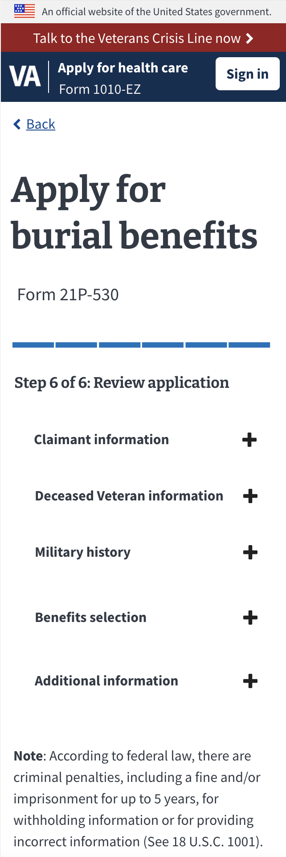
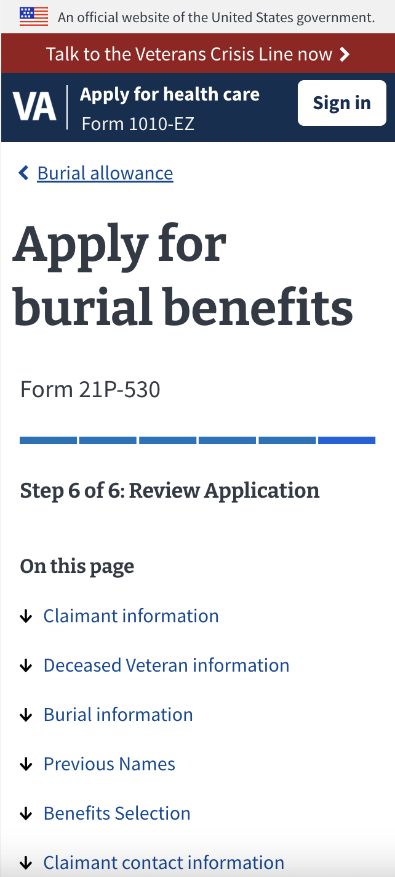
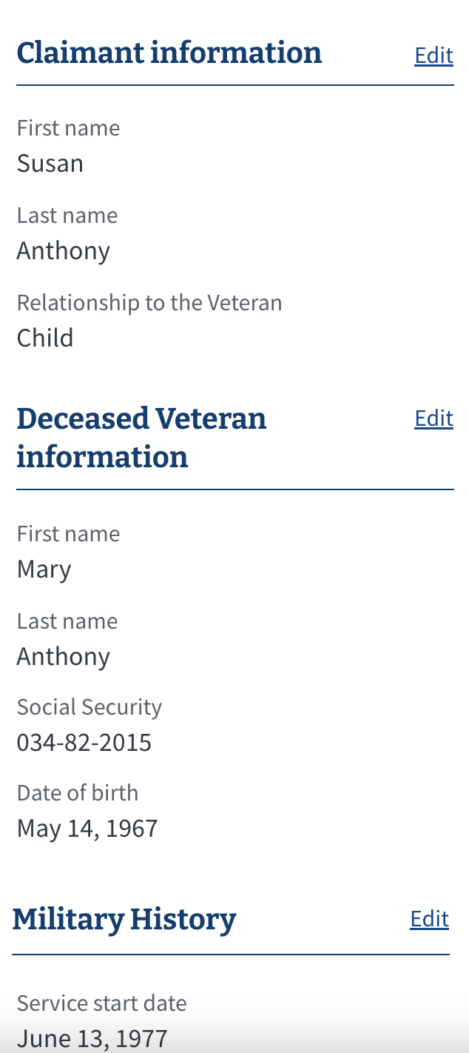
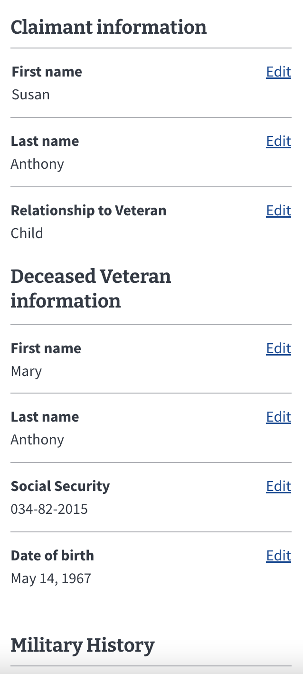
Mobile Design Options presented to the Veterans
Existing Design
Prototype Landing
Edit by Section
Edit by Field

Slide 14
What did we learn?

Slide 15
Key findings
Review Page Round 2 Usability Findings | August 2022
Most Veterans found success faster with the Edit by Section design.
Veterans found that the Edit by Section design had better ease of navigation and ease of reviewing and updating entire sections.
Qualitatively, Veterans were also able to navigate and intuitively understand how to update the Edit by Section design better than the Edit by Field design.
Though nearly all Veterans understood how to save a change and return to the Review Page without explanation, nearly half of them expressed confusion or uncertainty regarding the meaning of the Save & Continue, Back, and Continue buttons.
When returning to the Review Page after saving a change, all Veterans preferred being anchored to the section they just updated with a persistent confirmation notification.

Slide 16
Details of Findings
Review Page Round 2 Usability Findings | August 2022
Compared to the Edit by Field design, Veterans found that the Edit by Section design had less visual clutter. Especially for Veterans using the mobile version of the form, the higher number of edit hyperlinks introduced the potential to mis-click and end up editing the wrong field.
Some Veterans also felt uncertain about what would happen when clicking Edit in the Edit by Field design. Would the edit button open the field within the review page? Or would it open to the field in the section page? Comparatively, the edit by section design introduced less uncertainty.
"In this one I just hit an edit button next to the group I wanted to change, but in the other one I could just click on the edit button next to the thing I wanted to change instead of having to scroll through that information. I liked this one because I like how it has one button to go to all the information. I like design 1." - P14

Slide 17
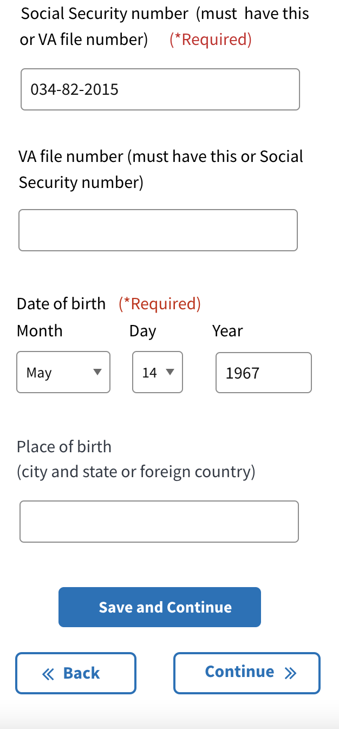
Details of Findings
Review Page Round 2 Usability Findings | August 2022
Though nearly all Veterans understood how to save a change and return to the Review Page without explanation, nearly half of them expressed confusion or uncertainty regarding the meaning of the Save & Continue, Back, and Continue buttons. Some felt that the form may not save their changes if they used the Back or Continue buttons.
"The big save and continue was perfect. There should not be any continue button, it should just be a save and continue. Say something happened and I had to run away from my computer - it would not have saved my information and I would have to start all over. I think just the one save and continue button is fine. I may even take the back button out." - P10

Slide 18
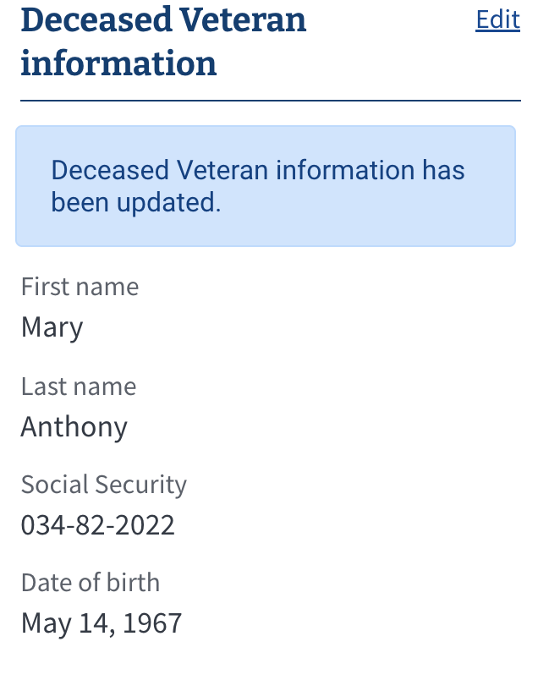
Details of Findings
Review Page Round 2 Usability Findings | August 2022
Veterans strongly prefer being anchored to the section they just edited after submitting an update. The persistent notification box is also useful for Veterans with slow internet connections, since it's easy for the connection to drop and a change to not go through.
"I would not like having to scroll all the way back down to see if I updated that [section]." - P12
"I like the highlight that says 'Previous Name has been updated.' That stands out." - P14
"I do like how [the blue box] verifies that the change went through." - P17

Slide 19
What do we do next?

Slide 20

Recommendations
Next Steps
(Q3 2022) The team will document the simple, medium, and complex form edit scenarios to inform future implementation guides for forms components.
(Time frame TBD) The team will reconsider the design purpose of the back and continue buttons with the help of the Design System Team.
(Time frame TBD) The team will implement a new review page using the "edit by section" pattern for the future VA Forms System Core working demo.

